Slide 1
AI-Driven Diffusion and LoRA Models for Customizable 3D Room Visualization and Design Enhancement
Presented By,
Abishek Amal A - 960321104015
Mohammed Nasim P - 960321104047
Thanush S - 960321104060
Vijay Martin - 960321104062
Guide by,
Ms.Mersha Spelly C
Assistant Professor
Department of Computer Science And Engineering
Bethlahem Institute of Engineering, Karungal

Slide 2
ABSTRACT
The proposed research aims to develop an AI-powered 3D construction modeling tool that leverages diffusion and LoRA (Low-Rank Adaptation) models to generate realistic and customizable 3D room images based on user-specified requirements. The system takes user input in the form of text descriptions, sketches, or mood boards, translating these inputs into detailed 3D representations of rooms. Diffusion models are used to generate initial room layouts and textures, while LoRA models provide the ability for fine-grained customization based on user feedback and preferences. This project strives to streamline the architectural design process, enhance creativity, and provide a more intuitive and efficient approach to creating 3D construction models.

Slide 3
EXISTING SYSTEM
Current 3D construction modeling tools typically require extensive manual input and a high level of technical expertise, making them inaccessible for non-professionals. These tools often demand a deep understanding of design principles and advanced 3D modeling skills, which can make the design process slow and cumbersome. Moreover, generating realistic and visually appealing 3D models can be challenging, especially for users without prior experience in 3D design. Although some AI-powered tools exist, they generally lack the ability to generate highly customizable models based on specific user inputs, leading to limited flexibility and satisfaction for the user.

Slide 4
DISADVANTAGES
Technical Expertise Required: Many existing systems demand advanced knowledge in 3D modeling and architectural design, limiting accessibility.
Time-Consuming Process: The manual design process is slow, requiring multiple iterations and extensive adjustments.
Limited Customization: Current AI-based tools often provide limited customization options for users to refine models according to personal preferences.
Inflexible Input: Most tools rely on either text or images for input, making them less versatile for users with varying design needs.
Quality Control: There is often no way for users to interactively adjust the generated designs to their liking in real-time, leading to a lack of satisfaction with the final output.

Slide 5
LITERATURE SURVEY
S No | Author(s) and Title | Summary | Relevance to the Project
1 | Gong, S. (2024). "Application of Stable Diffusion and LoRA Models in AI Drawing." | This paper explores the application of Stable Diffusion and LoRA models for AI-driven drawing tasks. The combination of these models allows for the generation of creative and high-quality art with more fine-grained control. | This paper is directly related to the use of diffusion and LoRA models for generating and customizing 3D room designs in our project.
2 | Peter, O. O. E., Rahman, M. M., & Khalifa, F. (2025). "Advancing AI-Powered Medical Image Synthesis: Insights from MedVQA-GI Challenge Using CLIP, Fine-Tuned Stable Diffusion, and Dream-Booth+ LoRA." | This research investigates the use of Stable Diffusion and LoRA models in medical image synthesis. The study emphasizes the integration of CLIP and fine-tuned models to generate highly specific medical images. | This work provides insights into the fine-tuning of diffusion models using LoRA, which aligns with the iterative refinement process in the proposed system.
3 | Chen, Y., & Ruan, H. (2025). "Deep Analogical Generative Design and Evaluation: Integration of Stable Diffusion and LoRA." | The paper integrates Stable Diffusion and LoRA models for generative design, focusing on their applications in mechanical design and evaluation. The system emphasizes the iterative enhancement of design elements. | This paper's focus on generative design and iterative refinement is highly relevant for the AI-powered customizable 3D room visualization in the project.

Slide 6
S No | Author(s) and Title | Summary | Relevance to the Project
4 | Chen, J., Shao, Z., Zheng, X., Zhang, K., & Yin, J. (2024). "Integrating aesthetics and efficiency: AI-driven diffusion models for visually pleasing interior design generation." | This research examines the use of AI-driven diffusion models to generate aesthetically pleasing interior designs. The system balances both visual appeal and functional efficiency through AI. | This paper is relevant as it focuses on using AI to generate interior designs, a core aspect of the proposed system for 3D room design.
5 | Liu, R., Pang, W., Chen, J., Balakrishnan, V. A., & Chin, H. L. (2024). "The application of scaffolding instruction and AI-driven diffusion models in children’s aesthetic education: A case study on teaching traditional Chinese painting of the twenty-four solar terms in Chinese culture." | This study applies AI-driven diffusion models in the context of children’s education, specifically for traditional Chinese painting. It integrates instructional scaffolding to improve artistic creativity. | This paper illustrates the versatility of AI-driven diffusion models for creative tasks, similar to how the proposed system uses these models for room design creation.

Slide 7
PROPOSED SYSTEM
The proposed system will offer an AI-powered 3D construction modeling tool that generates customizable 3D room images from user inputs, such as textual descriptions, sketches, or mood boards. Using a combination of diffusion models and LoRA (Low-Rank Adaptation) models, the system will first generate an initial room layout with basic furniture and textures based on the user's input. LoRA models will enable fine-tuning and customization, allowing users to modify the design based on their preferences. The iterative refinement process will allow users to continuously adjust the design until the desired 3D room is achieved. The system aims to democratize 3D modeling, making it more accessible to non-professionals and enhancing the creative process in architectural design.

Slide 8
ADVANTAGES
User-Friendly: Simplifies 3D design by removing the need for technical expertise, making it accessible to a wider audience.
Multimodal Input: Supports various forms of user input (text, sketches, mood boards), enhancing flexibility and creativity.
Customization: The LoRA-based model allows for fine-grained customization of room designs, offering greater control to users.
Iterative Refinement: Users can provide feedback and make changes in real-time, ensuring the final design aligns with their vision.
High-Quality Results: Generates realistic, photorealistic 3D designs, ensuring a high-quality output that matches professional standards.

Slide 9
Technique or Algorithm Used
Diffusion Models: Used to generate the initial 3D room layout, textures, and furniture placements based on user inputs. These models are pre-trained and are fine-tuned with user-specific data.
LoRA (Low-Rank Adaptation): LoRA is used to enable customization and fine-tuning of the generated 3D room models, allowing for adjustments based on user feedback.
Deep Learning: Techniques such as CNNs (Convolutional Neural Networks) and GANs (Generative Adversarial Networks) may be incorporated for refining textures and enhancing room features.
Iterative Design Process: The system incorporates feedback loops to continually refine the design, ensuring a highly personalized user experience.

Slide 10
MODULES
User Input Module: Collects user inputs such as textual descriptions, sketches, or mood boards.
Diffusion Model Module: Generates the initial 3D room layout based on user input using diffusion-based techniques.
Customization and Fine-Tuning Module: Uses LoRA models to allow users to fine-tune room features such as layout, colors, and furniture placement.
Iterative Refinement Module: Processes user feedback and updates the 3D design iteratively until the desired outcome is achieved.
3D Visualization Module: Renders the final 3D model in a high-quality, photorealistic format for user viewing.
User Feedback Module: Allows users to provide feedback and suggestions for further customization.
Export and Save Module: Provides options for users to save or export their finalized 3D designs.

Slide 11
REFERENCES
Gong, S. (2024). Application of Stable Diffusion and LoRA Models in AI Drawing. Applied and Computational Engineering, 97, 12-17.
Peter, O. O. E., Rahman, M. M., & Khalifa, F. (2025). Advancing AI-Powered Medical Image Synthesis: Insights from MedVQA-GI Challenge Using CLIP, Fine-Tuned Stable Diffusion, and Dream-Booth+ LoRA. arXiv preprint arXiv:2502.20667.
Chen, Y., & Ruan, H. (2025). Deep Analogical Generative Design and Evaluation: Integration of Stable Diffusion and LoRA. Journal of Mechanical Design, 147(5).
Chen, J., Shao, Z., Zheng, X., Zhang, K., & Yin, J. (2024). Integrating aesthetics and efficiency: AI-driven diffusion models for visually pleasing interior design generation. Scientific Reports, 14(1), 3496.
Liu, R., Pang, W., Chen, J., Balakrishnan, V. A., & Chin, H. L. (2024). The application of scaffolding instruction and AI-driven diffusion models in children’s aesthetic education: A case study on teaching traditional chinese painting of the twenty-four solar terms in chinese culture. Education and Information Technologies, 1-32.

Slide 12
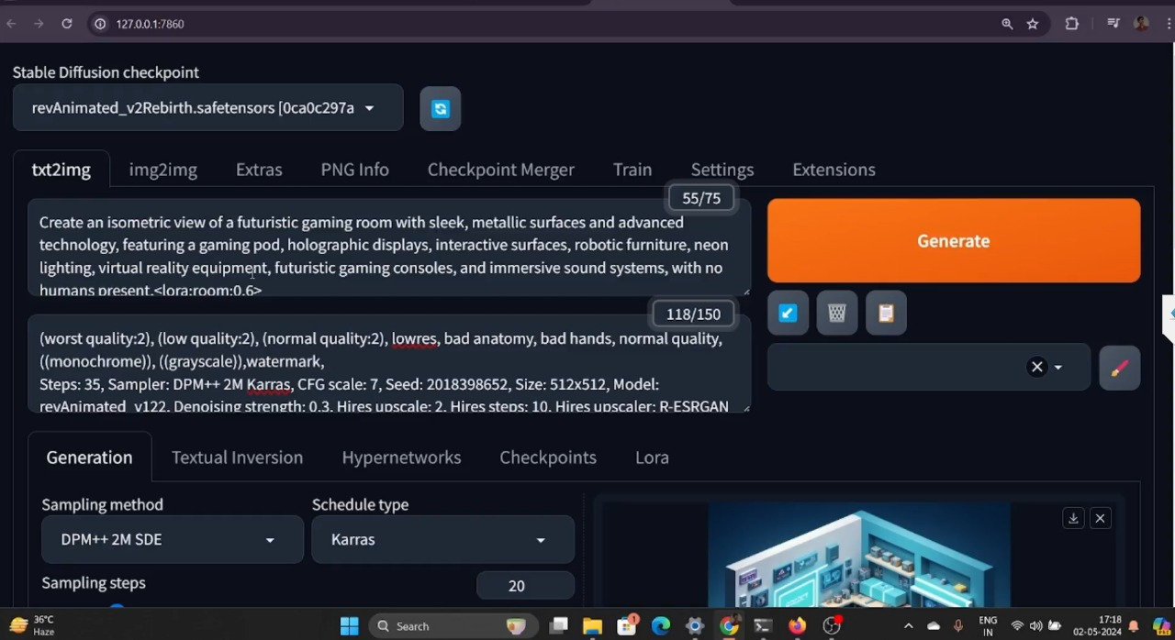
Output Screenshots

Slide 13
